Slide 1


DESIGN ANALYSIS
Conceptual Design
Physical Design

Slide 2
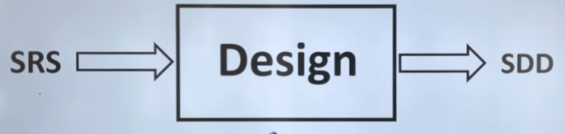
Requirements
SYSTEMS DEVELOPMENT LIFE CYCLE (SDLC)
Developed first
Agreement between client and analyst
Describes what the system will provide and any constraints
Natural language and conceptual diagrams
SRS: Software Requirements Specification
SDD: Software Design Document
Specifications
Precise/specific statement of requirements
Agreement between client and developers
Describes the “how” in non-technical terms
Formal notation and more detailed diagrams
Design

Slide 3
SYSTEMS DEVELOPMENT LIFE CYCLE (SDLC)
In the Design Phase is most creative process readable and easy to understand, where it translates requirements into a detailed plan, outlining the system's architecture, components, and interfaces, ensuring the product is fulfill the criteria functionally and technically, it must contain all the requirement which were given in SRS .
Key Activities and Goals:
Detailed Specification: The design phase converts the requirements gathered in the previous phases into detailed specifications, including system architecture, database design, user interface, and software components.
System Architecture: Defining the overall structure and organization of the system, including modules, interfaces, and data flow.
Component Design: Designing individual software components and their interactions, ensuring they meet the system's requirements.
Database Design: Planning the structure and organization of the database, including tables, relationships, and data types.

Slide 4
SYSTEMS DEVELOPMENT LIFE CYCLE (SDLC)
User Interface Design (UI/UX): Designing the user interface to ensure it is user-friendly and intuitive (Real look).
Security Planning: Identifying and addressing potential security risks and vulnerabilities.
Technology Selection: Choosing the appropriate technologies and tools for developing the system.
Documentation: Creating detailed documentation, including design specifications, architecture diagrams, and user manuals.

Slide 5
SYSTEMS DEVELOPMENT LIFE CYCLE (SDLC)
Outcomes of the Design Phase:
System Architecture Diagram: A visual representation of the system's structure and components.
Database Design Document: A document outlining the database schema, tables, and relationships.
User Interface Design Mockups: Prototypes or sketches of the user interface.
Software Component Specifications: Detailed specifications for each software component.
Design Document: A comprehensive document summarizing the design decisions and specifications.

Slide 6
SYSTEMS DEVELOPMENT LIFE CYCLE (SDLC)
Importance of the Design Phase:
Foundation for Development: The design phase provides the foundation for the subsequent development phase, ensuring that the developers have a clear understanding of the system's structure and components.
Ensuring Functionality and Technical Soundness:
A well-designed system is more likely to be functional, reliable, and maintainable.
Identifying Potential Problems Early:
The design phase allows for identifying potential problems and issues early in the development process, reducing the risk of costly rework later on.
Facilitating Communication:
The design phase facilitates communication between stakeholders, including developers, clients, and end-users, ensuring that everyone is on the same page.

Slide 7
SYSTEMS DEVELOPMENT LIFE CYCLE (SDLC)
WHEN WE COMPLETE THE DESIGN?
We have:
  Screen and report layouts
  User instructions
  Specifications for programmers (Algorithms & Flow charts..etc)
  Instructions for operations
  Backup and restart/recovery instructions
  An audit trail (facilitate verification and accountability)
  Documented
Software Architecture
Global structure of processing components and data structures
Software Design
Transformation of specifications into data structures and algorithms

Slide 8
SYSTEMS DEVELOPMENT LIFE CYCLE (SDLC)
Software Design Issues / Challenges
Partitioning Specifications
Choosing Data And Software Criteria For Partitioning
Representing Information, Processing Steps, Control Flow…
Separating Function And Data Detail From Abstractions
Designing In Testability, Maintainability
Achieving A Complete, Consistent, High-quality Design

Slide 9
SYSTEMS DEVELOPMENT LIFE CYCLE (SDLC)
What To Design?
Business procedures
User instructions
Operating instructions
Codes
Data
Processes
Interfaces
Controls
Security
Audit trails
Backup/recovery
Fault prevention
Exception handling
Test data
Test methods/plans
In addition to documenting the design
  Design rationale
  Performance constraints

Slide 10
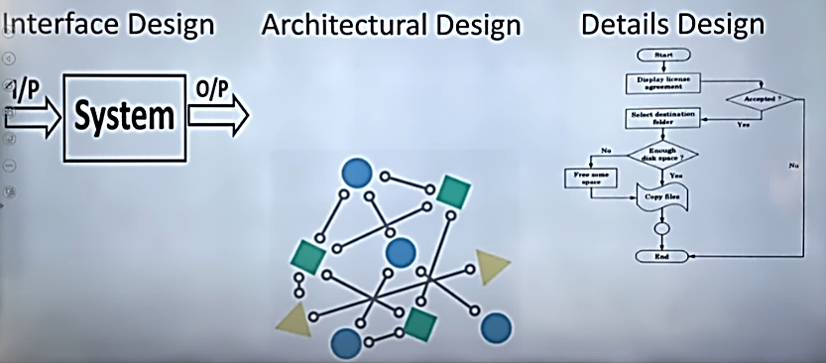
SYSTEMS DEVELOPMENT LIFE CYCLE (SDLC)
Steps of Design?

Slide 11
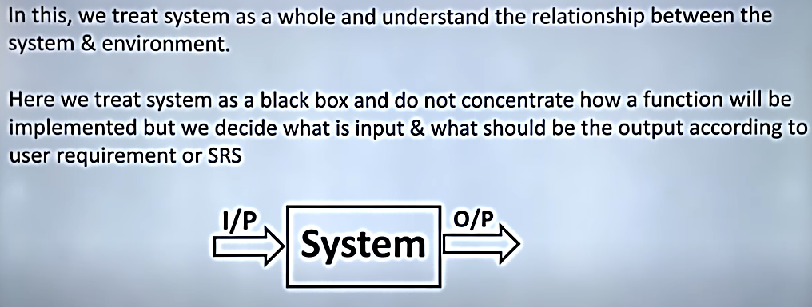
SYSTEMS DEVELOPMENT LIFE CYCLE (SDLC)
Interface Design?
Black Box evaluates functionality without knowledge of the internal code.
White Box testing examines the internal workings, including code and logic, to identify potential issues

Slide 12
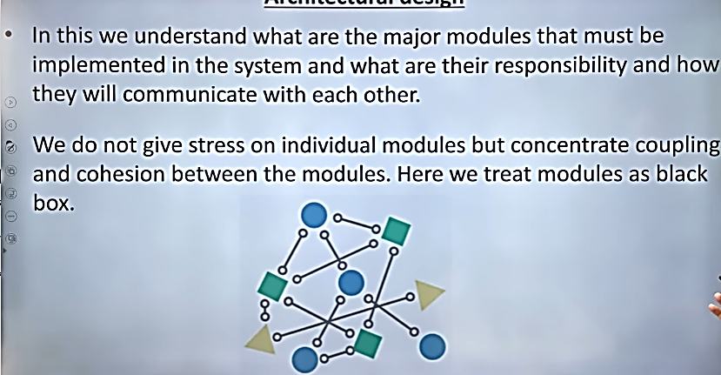
SYSTEMS DEVELOPMENT LIFE CYCLE (SDLC)
Interface Design?

Slide 13
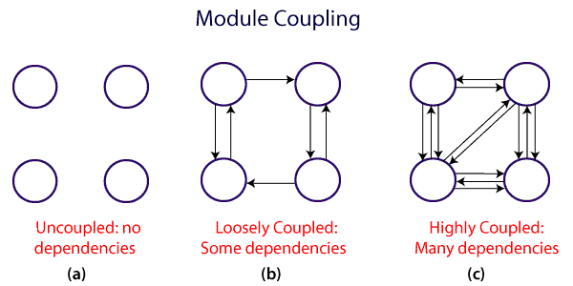
SYSTEMS DEVELOPMENT LIFE CYCLE (SDLC)
Coupling & Cohesion
Coupling and cohesion are two parameters on which we can understand the quality of modularity in the design of a software.
Coupling:
The measure of interdependence of one module over another module

Slide 14
SYSTEMS DEVELOPMENT LIFE CYCLE (SDLC)
Coupling Types
Data Coupling (Low Coupling):
Modules interact by passing simple data as parameters.
  Example: A function calculate_total(price, quantity) takes two primitive data types as input.
Stamp Coupling (Moderate Coupling):
Modules share complex data structures (like objects or records).
  Example: A function process_customer(customer_record) takes a customer_record object as input.
Control Coupling (Moderate Coupling):
One module controls the behavior of another by passing control flags or parameters.
  Example: A function process_order(order_type, order_details) uses the order_type parameter to determine which processing logic to use.

Slide 15
SYSTEMS DEVELOPMENT LIFE CYCLE (SDLC)
Common Coupling (Moderate Coupling):
Modules share global data or a common database, creating dependency.
  Example: Multiple modules access the same global variable or database table.
Content Coupling (High Coupling):
One module directly accesses or modifies the internal data or code of another module, creating tight dependency.
  Example: Module A directly accesses and modifies the internal variables of Module B.
Message Coupling (Low Coupling):
Modules communicate through messages or events, promoting loose coupling.
  Example: Modules interact by sending and receiving messages through a message queue.
External Coupling: Modules are coupled through an external data format or communication protocol (Databases, APIs..etc).

Slide 16
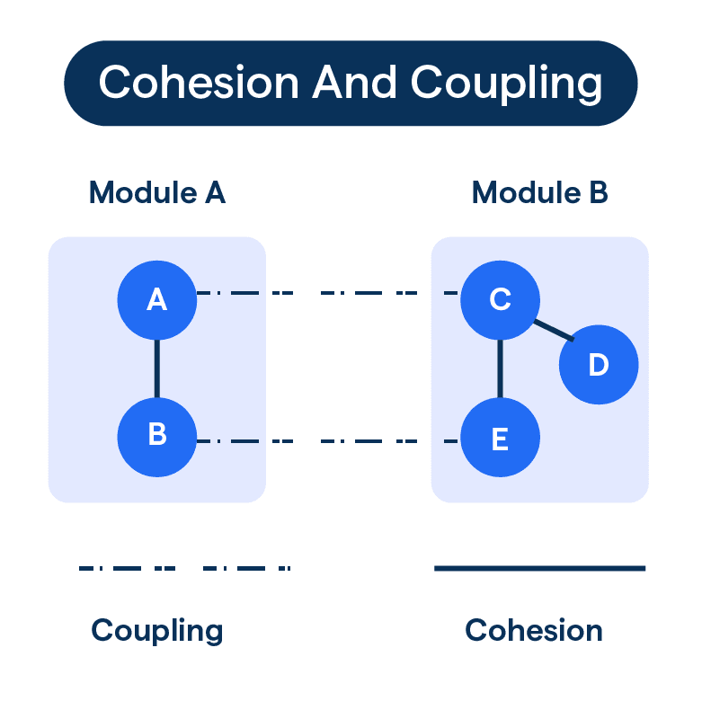
SYSTEMS DEVELOPMENT LIFE CYCLE (SDLC)
Coupling & Cohesion
Cohesion: is the crucial concept in software engineering, representing how closely related and focused the functionalities are within a single module or class are. High cohesion within a module or class leads to better maintainability, understandability, and reusability of code.

Slide 17
SYSTEMS DEVELOPMENT LIFE CYCLE (SDLC)
Cohesion Types
Functional Cohesion (High Cohesion):
All elements within a module are related to a single, well-defined function or task.
Example: A module responsible for calculating the total cost of an order.
Sequential Cohesion (Moderate Cohesion):
Elements are related because they are executed in a specific sequence.
Example: A module that first function output then 2nd output ..and so on….. Until final out come.
Communicational Cohesion (Moderate Cohesion):
Elements are related because they operate on the same data structure.
Example: A module that manages user accounts and their associated data.
Procedural Cohesion (Moderate Cohesion):
Elements are related because they are executed in a specific sequence.
Example: A module that first validates data, then processes it, and finally stores it.

Slide 18
SYSTEMS DEVELOPMENT LIFE CYCLE (SDLC)
Cohesion Types
Temporal Cohesion (Low Cohesion):
Elements are related because they are performed at the same time.
Example: A module that handles both input and output operations during the same event.
Logical Cohesion (Low Cohesion):
Elements are related because they perform similar logical operations.
Example: Input , output functions…..
Coincidental Cohesion (Low Cohesion):
Elements within a module are unrelated mean a module is collection of randam function from different module, making it difficult to maintain and reuse.
Example: A module that contains unrelated functions, such as calculating the area of a circle and printing a user's name.

Slide 19
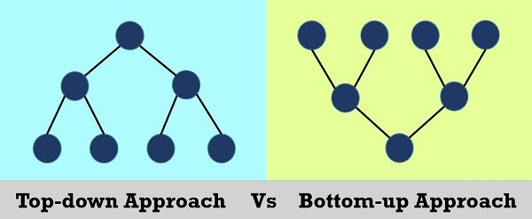
SYSTEMS DEVELOPMENT LIFE CYCLE (SDLC)
Desgin Approaches
The Top-down Approach involves starting with a high-level overview of the system and then progressively breaking it down into smaller, more manageable components and subcomponents until the desired level of detail is reached.
The Bottom-up Approach involves starting with the smallest, most basic components and building upwards, gradually integrating them into larger, more complex systems.

Slide 20
SYSTEMS DEVELOPMENT LIFE CYCLE (SDLC)
Desgin Approaches
The Top-down Approach Benefits:
Clear Structure: Helps create a well-structured and organized system.
Easier Maintenance: The modular nature makes it easier to maintain and modify the system.
Improved Collaboration: A top-down approach facilitates better communication and collaboration among developers.
Early Error Detection: By focusing on the big picture first, potential issues can be identified and addressed early in the development process.
The Bottom-up Approach Benefits
Modularity and Reusability: This approach promotes the creation of modular, reusable components, which can be beneficial for future projects.
Incremental Development: It allows for incremental development and testing, making it easier to identify and fix problems early on.
Focus on Low-Level Details: It allows developers to focus on the details of the basic components before addressing the complexities of the overall system.
.

